Slide 1
Riley County Community Health Improvement Planning Meeting
March 11, 2015

Slide 2
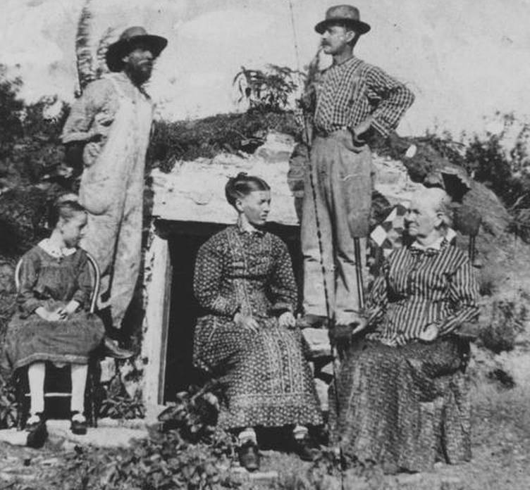
Can we Make a Difference in our Community’s Health?

Slide 3
Aligning Assessments Efforts
Multiple related efforts have been taking place over the past several months
Comprehensive Community Needs Assessment
Community Survey – over 1,000 respondents
Stakeholder Interviews
Focus Groups
Data Review
Local Public Health Systems Performance
Review of the Public Health System by Subject Matter Experts and Community Stakeholders
Community Health Improvement Plan
Determining top health priorities to address and improve through coordinated efforts in the next 3-5 years.
Many community partners have been involved

Slide 4
Comprehensive Community Needs Assessment Key Partners
Project coordination provided by
Riley County
Seniors’ Service Center
Funding provided by:
Caroline F. Peine Charitable Foundation (Manhattan Fund)
Konza United Way
Mercy Regional Health Center
Riley County Council on Aging
Wamego Health Center
Conducted by Center for Community Support & Research
Wichita State University
Design Team Members:
Konza United Way
Mercy Regional Health Center
Riley County Health Department
Riley County Seniors’ Service Center
For full report, see www.rileycountycommunityneedsassessment.org

Slide 5
Community Meetings for Public Input
✓ Thursday, January 29
Manhattan – Community Leader Meeting
✓Sunday, February 8
Manhattan
2-3:30pm
✓ Wednesday, Feb. 25
Keats
7:30-8:30pm
TBD
Spanish-speaking
✓ Thursday, February 12
Manhattan
1-2:30pm
✓ Monday, Mar. 2
Randolph
12:00-1:00pm
April 9
First United Methodist Church
Manhattan
3:00-5:00pm
Next steps – all are welcome!
✓ Wednesday, February 18
Riley
6:30-8:00pm
✓ Wednesday, Mar. 4
Randolph
7:00-8:00pm
✓ Tuesday, February 24
Ogden
6:00-7:30pm
✓ Thursday, March 5
Leonardville
6:30-8:00pm

Slide 6
Demographic Overview - Population Distribution

Slide 7
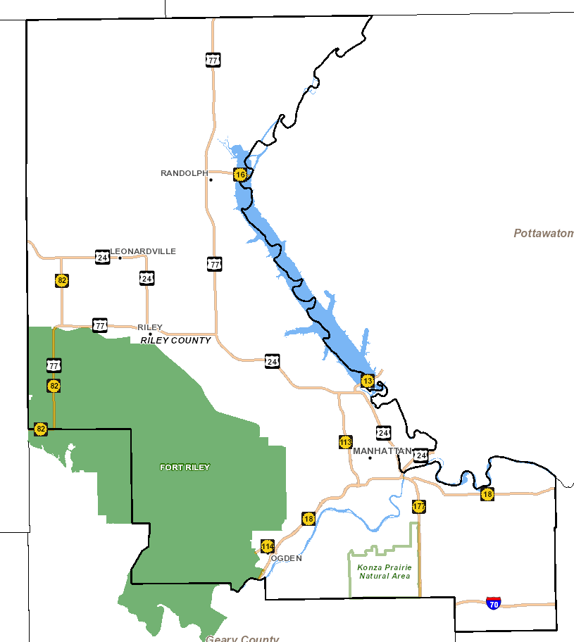
Notes:
2011-2013
Riley Co: 74,893
Manhattan: 55,483

Slide 8
Demographic Overview - Population Distribution

Slide 9
Notes:
2011-2013
Riley Co: 74,893
Manhattan: 55,483

Slide 11
* 2009 – 2013 ACS Census Estimates

Slide 12
Socioeconomic Overview - Income - Education

Slide 13
* 2009 – 2013 ACS Census Estimates

Slide 14
* 2009 – 2013 ACS Census Estimates

Slide 15
* 2009 – 2013 ACS Census Estimates
Notes:
1 person – about $12,000
2 people – about $16,000
Family of 4 with 2 adults and 2 children < 18 – about $24,000

Slide 16
* 2011 – 2013 ACS Census Estimates

Slide 17
Riley County Comprehensive Community Needs Assessment (CCNA)
Overview

Slide 18
“The overarching theme of the data collected is that Riley County is a community that is divided between a high quality of life, prosperity, and growth on one hand, and dwindling resources for and lack of attention to those who are most in need on the other.”
18

Slide 19
Overview of CCNA Findings
High quality of life
Growth
Spirit of community and collaboration
“Invisible” population with significant needs
Lack of accessible and affordable mental health services
Lack of affordable housing
Lack of accessible and affordable child care

Slide 20
Quality of Life
Riley County Comprehensive Community Needs Assessment

Slide 21
Quality of Life Findings
Percent respondents who “agree” or “strongly agree”
88% There are opportunities to volunteer in my community
87% This is a safe place to live
86% This is a good place to raise children
85% This is a beautiful place to live
82% I am satisfied with the quality of life in this community
41% I am satisfied with local government
39% All residents think that they can make the community a better place to live

Slide 22
Quality of Life: High-Low Game
Which did respondents score most important? (The rest were least important.)
Resources for Parents
Good schools
Low disease rates
Low level child abuse
Low disease rates

Slide 23
Most Important Factors that Contribute to Quality of Life
Percent respondents who selected these among their top three:
33% Good schools
30% Good place to raise children
25% Clean environment
24% Safe neighborhoods
19% Healthy economy
18% Low crime

Slide 24
Physical Health
Riley County Comprehensive Community Needs Assessment

Slide 25
Health Data from Secondary Sources (2013 data, unless otherwise indicated) | Kansas | Riley County
Percent adults with fair or poor self- perceived health status | 15.4% | 8.7%
Percent population without health insurance | 12.3% | 6.2%
Percent adults with hypertension | 31.3% | 18.9%
Percent adults tested and diagnosed with high cholesterol | 38.1% | 28.6%
Percent adults diagnosed with diabetes | 9.6% | 4.5%
Rate of age-adjusted cancer (all cancers, per 100,000, 2007-2011) | 21.1 | 15.5

Slide 26
Leading Causes of Death
Riley County Comprehensive Community Needs Assessment

Slide 27
Leading Causes of Death (2009-2013)
Kansas
Cancer
Heart Disease
Chronic Lower Respiratory Diseases
Unintentional Injuries
Stroke
Alzheimer’s Disease
Diabetes
Pneumonia & Influenza
Kidney Disease
Suicide
Riley County
Cancer
Heart Disease
Stroke
Chronic Lower Respiratory Diseases
Unintentional Injuries
Pneumonia & Influenza
Alzheimer’s Disease
Diabetes
Kidney Disease
Suicide

Slide 28
Key Health Indicators
Riley County Comprehensive Community Needs Assessment

Slide 30
Local Public Health Systems Assessment

Slide 31
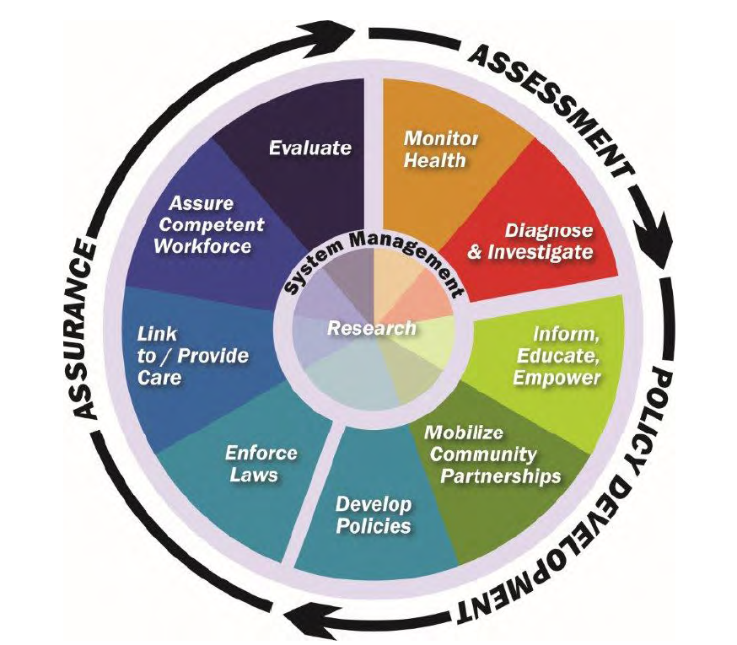
Local Public Health Systems Assessment (LPHSA)
What is public health? Activities that society undertakes to assure the conditions in which people can be healthy.
The public health system is more than the public health agency…it involves all public and private entities that contribute to public health and the health and well-being of a community.
10 Essential Public Health Services provided the framework for the assessment instrument
10 services and related “model standards” describe an optimal level of performance and capacity
Approximately 100 people participated in the assessment in June 2014
See report for detailed description of scoring instrument, process, and results

Slide 32
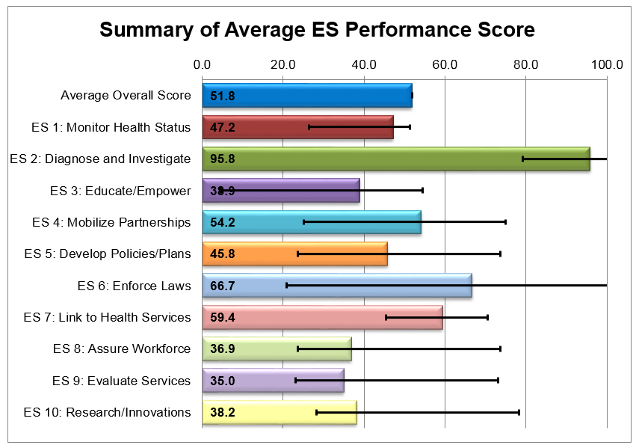
Local Public Health System Assessment (LPHSA) Results
Overall, the Riley County Public Health System scored very favorably
No essential services performed in the “No Activity” (0%) or “Minimal Activity” (1-25%) range.

Slide 33
Overall LPHSA Observations
Much work is being done (lots of resources, lots of organizations, doing a lot of good things)…but many (including community leaders, providers, organizations, and the public) don’t know about it
Some essential services are lacking a central authority or lead organization to take fully implement or utilize resources in an intentional, coordinated way
Need for increased communication, coordination, and linkages within the local public health system
Need to expand local public health system’s ability to share and use data and informational resources
General lack of awareness the public health system
Concerns related to mental health
Concerns related to Northern Riley County

Slide 34
Facilitated Group Discussion: In your opinion, what are the top health needs that must be addressed in the next 3-5 years? What will be the most impactful to improve our community’s health?

Slide 35
Large Group Voting – Distribute your dots (votes) in any way you choose

Slide 36
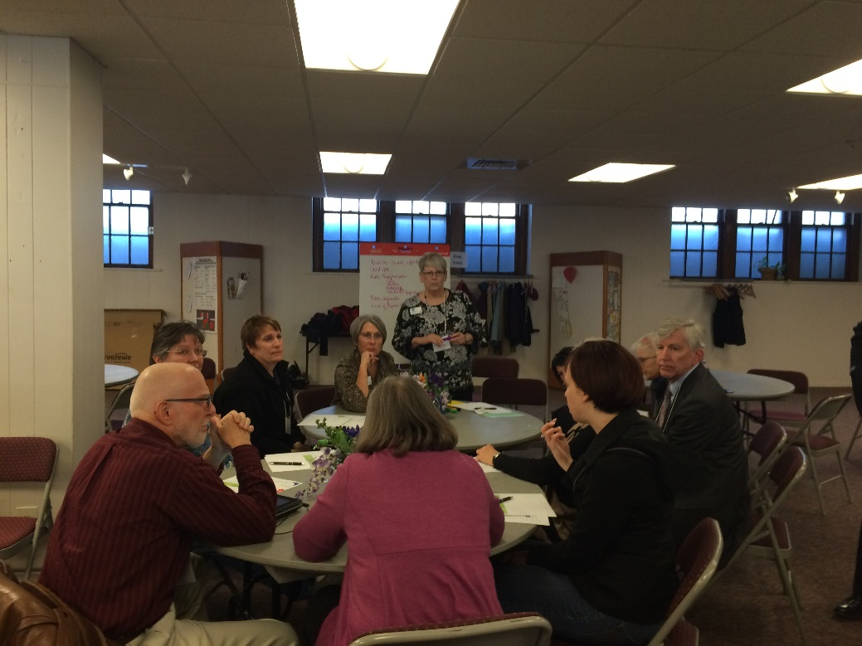
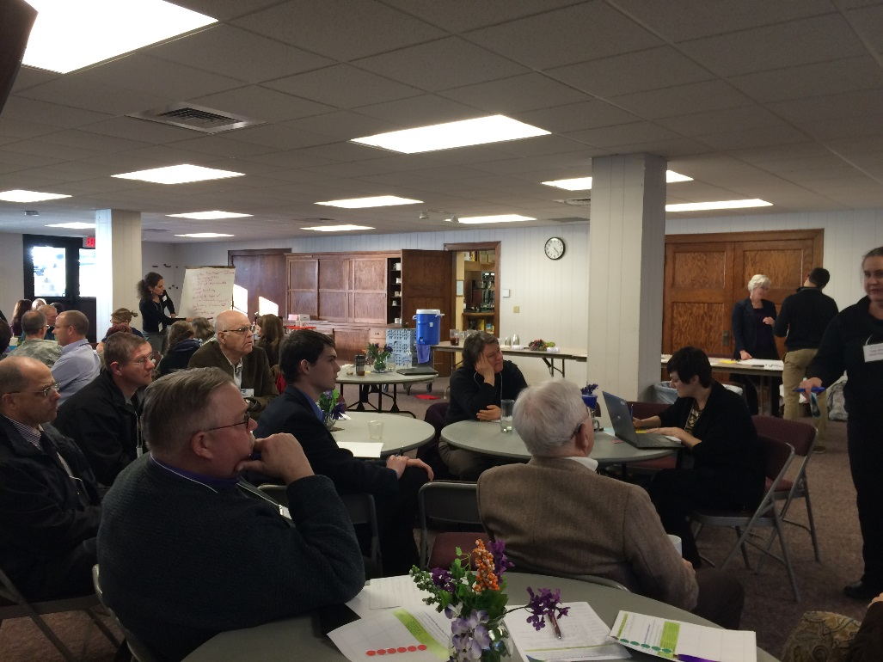
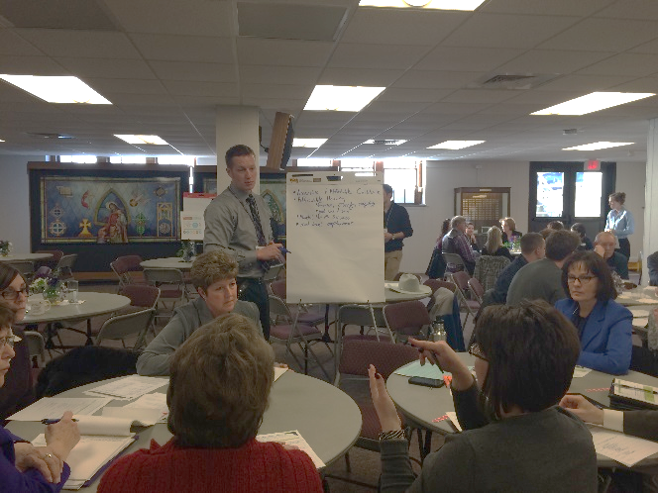
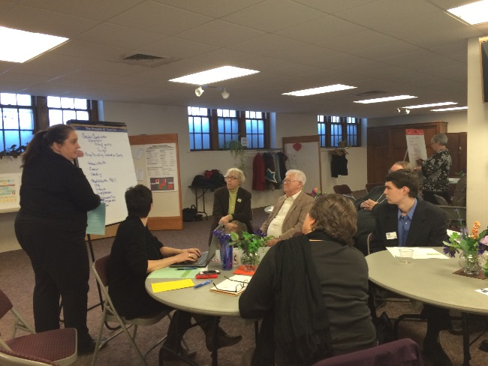
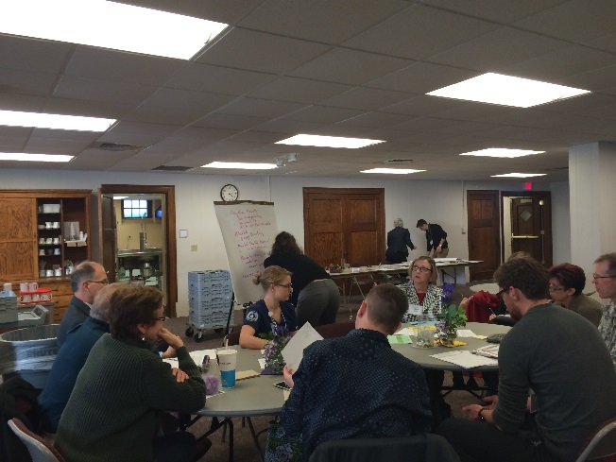
Leaders’ Meeting
January 29

Slide 37
Leaders’ Meeting Top Voting Results
January 29
Topic – Top 3 Suggested by Each Group | Votes
Mental Health and Substance Abuse | 61
Transportation | 46
Employment Opportunities | 37
Affordable Housing | 37
Healthy Habits | 35
System Communication | 26
Coordination | 22
Affordable Services | 22
Affordable Child Care | 15

Slide 38
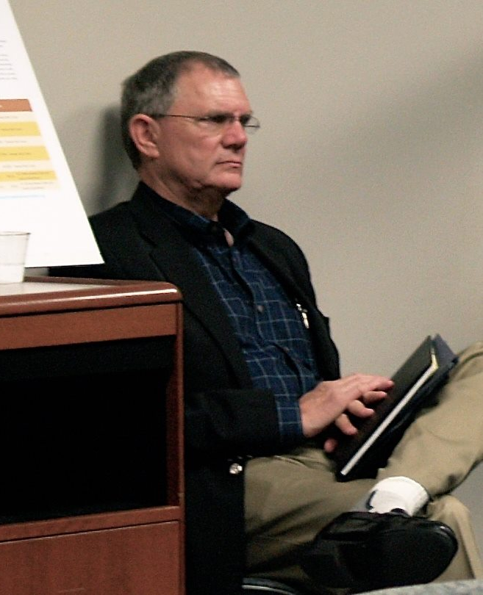
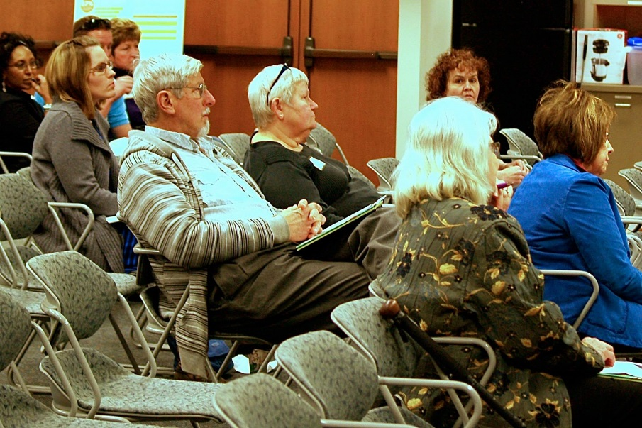
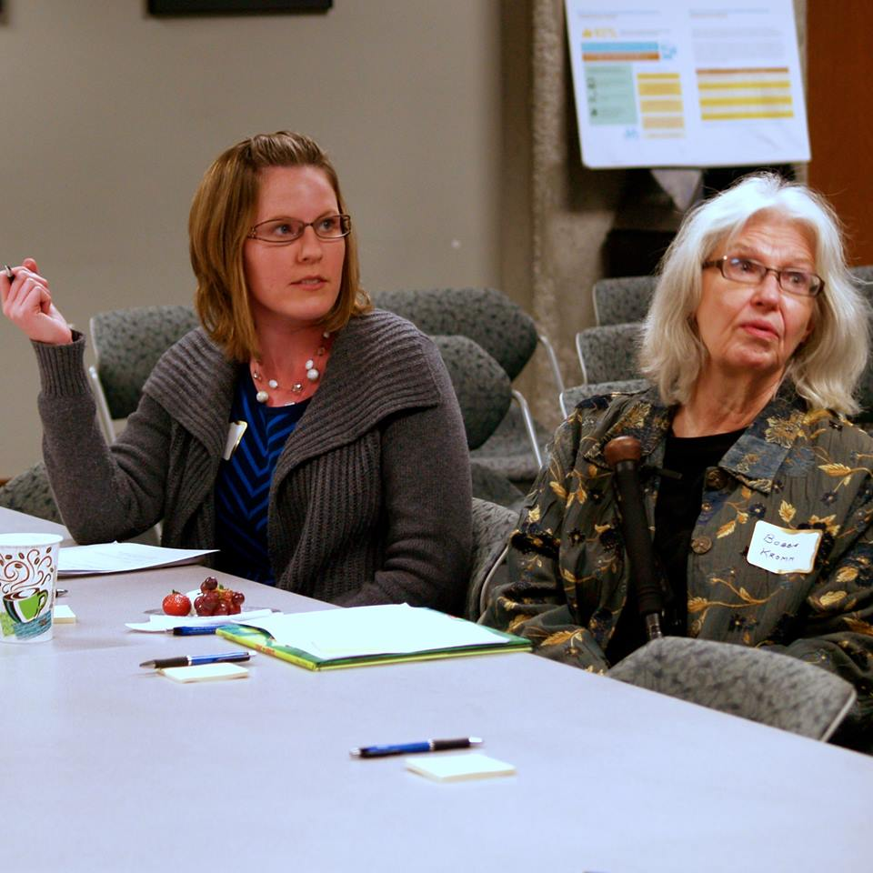
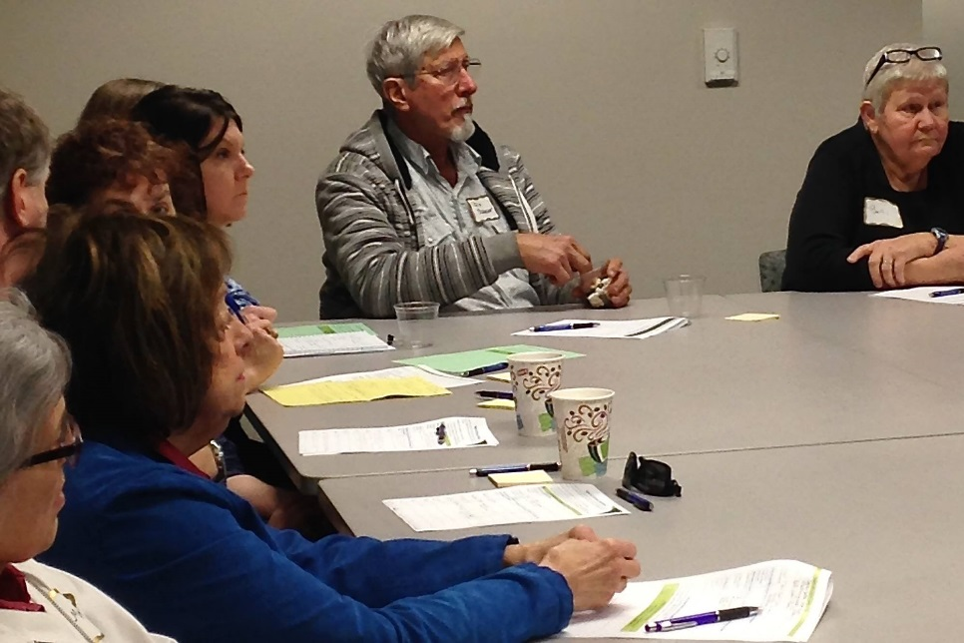
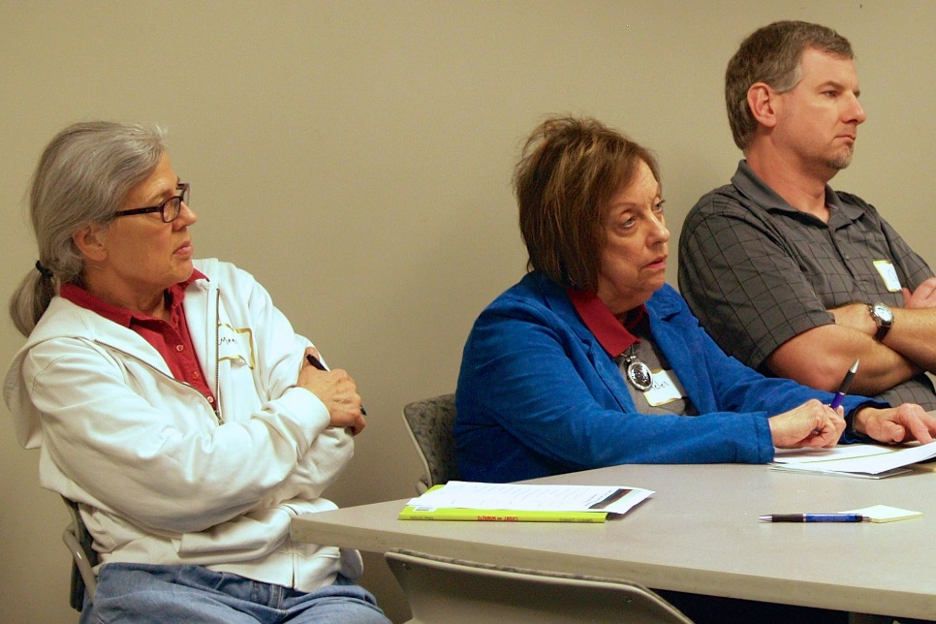
Manhattan #1 Meeting
February 8

Slide 39
Manhattan Meeting #1 Top Voting Results
February 8
Priority | Votes
Mental Health Services - Stigma | 7
Pediatric Psychiatrists (also need psychiatrists for general populations) | 7
Women’s Health Care - prenatal and education, also education in high schools | 6
Childcare, especial for 0-2 years, preschool education | 6
Crisis Stabilization Unit (Mental Health unit at hospital) | 6
Transportation – ATA bus affordability, routes, timing | 5
Dental Care for Kids and Adults | 5

Slide 40
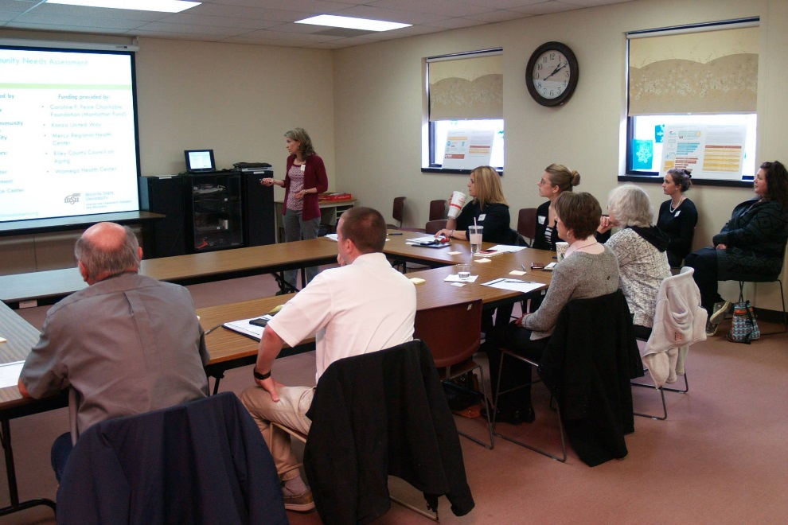
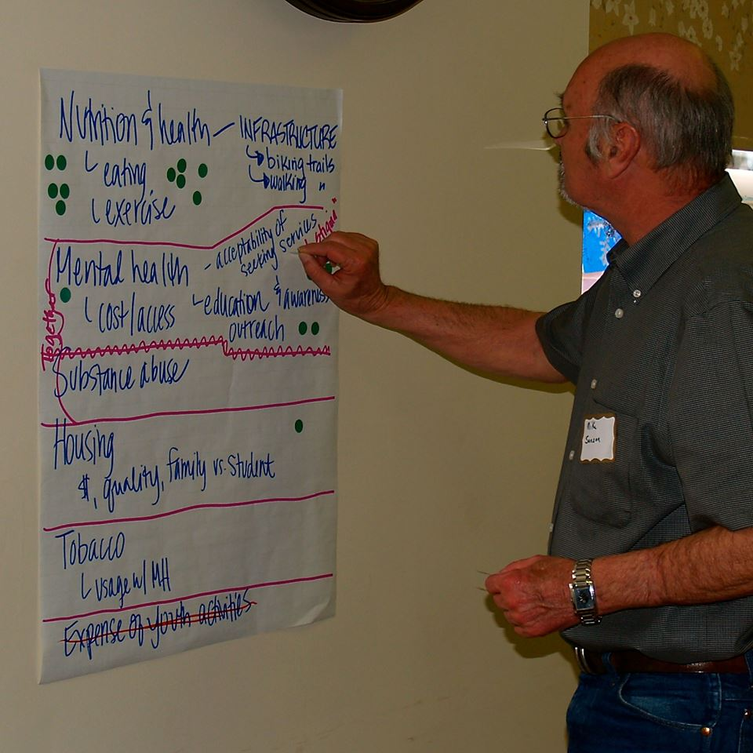
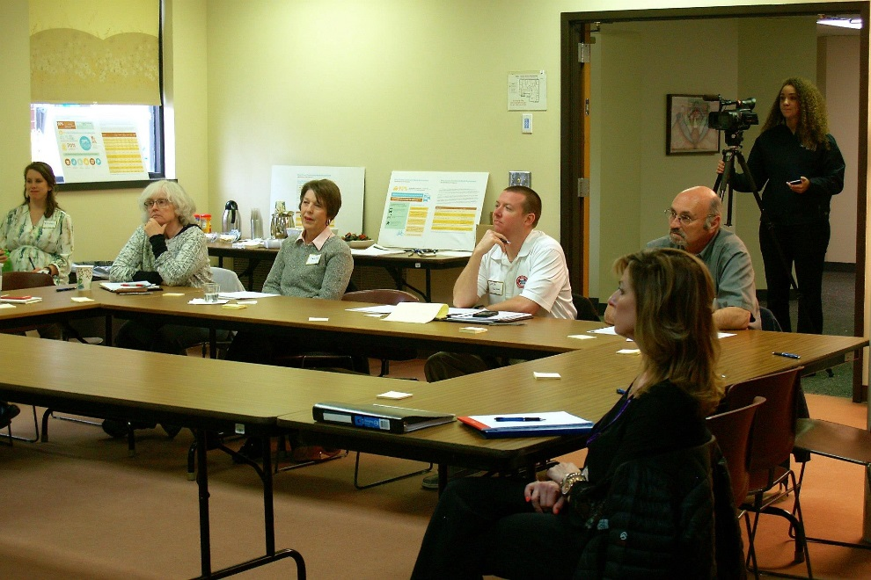
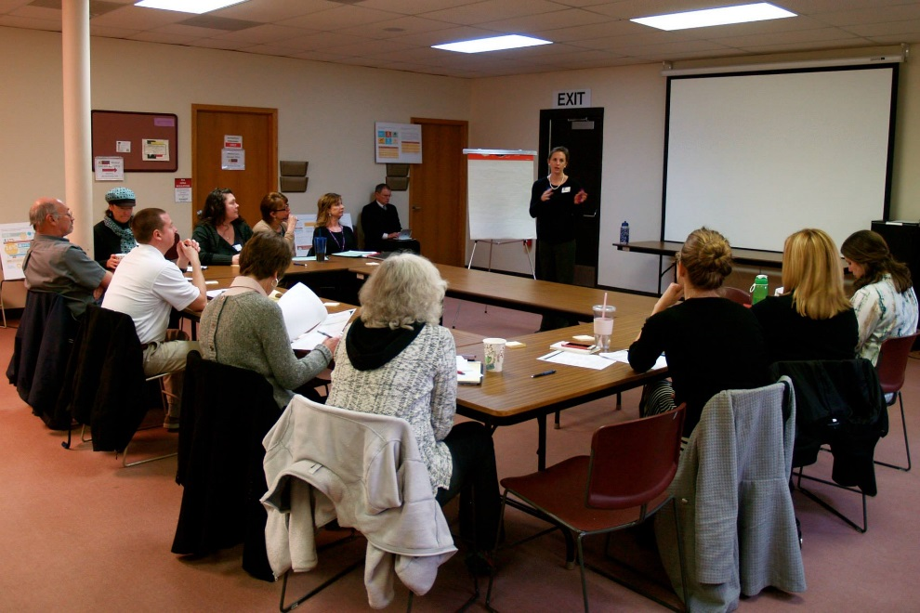
Manhattan, February 12

Slide 41
Manhattan Meeting #2 Top Voting Results
February 12
Priority | Votes
Nutrition & Health | 18
Mental Health Acceptability of seeking services, “decrease stigma” Education & awareness outreach Cost/access | 17
Affordability of recreation | 9
Mental Health Lack of beds Psychiatric services and medications (insufficient providers) | 6
Communication and awareness of social service programs in general | 4

Slide 42
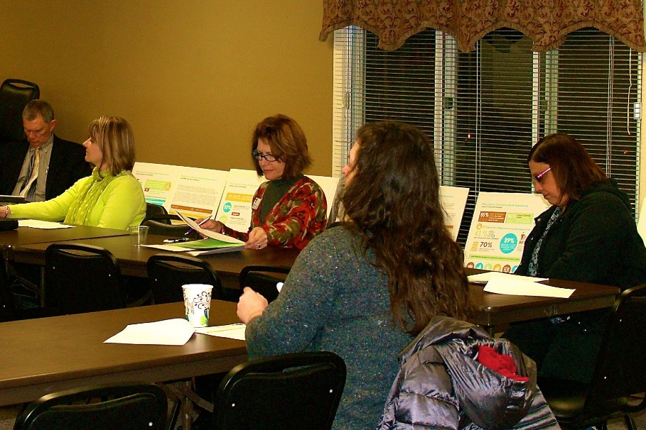
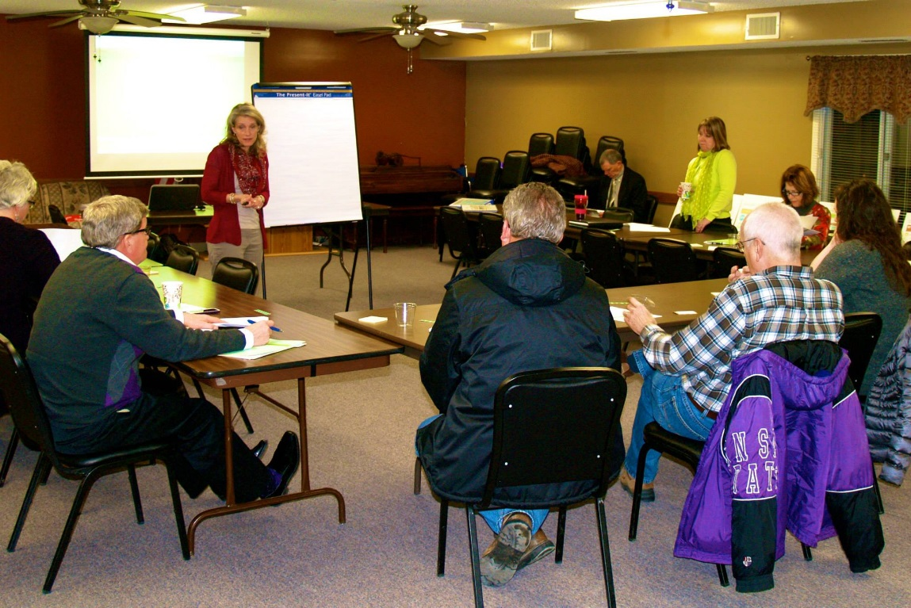
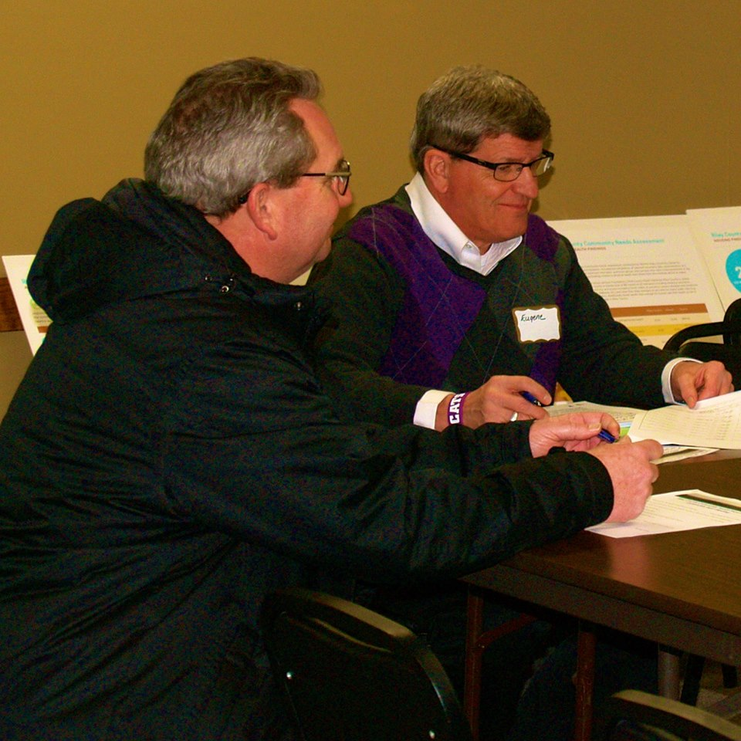
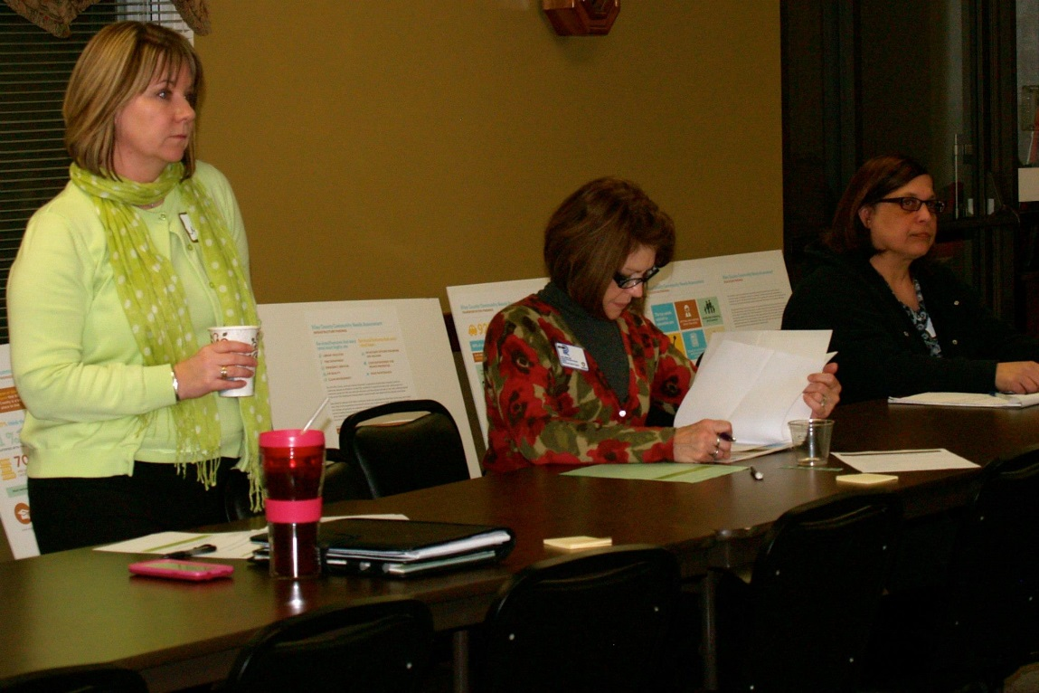
Riley, February 18

Slide 43
Riley Top Voting Results
February 18
Priority | Votes
Special Needs | 7
Single access point for services: housing, child care, health, mental health, food pantry, medical card, food stamps, dentists | 7
Access to medical services in the rural areas | 7
Mental Health throughout the community | 7
Lack of child care in rural areas; no after school care | 6
Transportation | 5

Slide 44
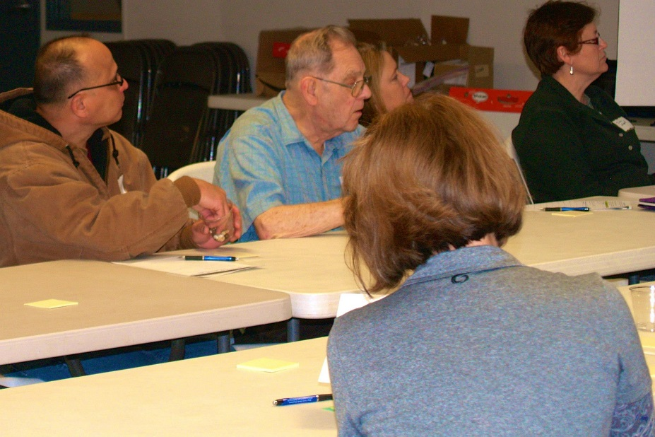
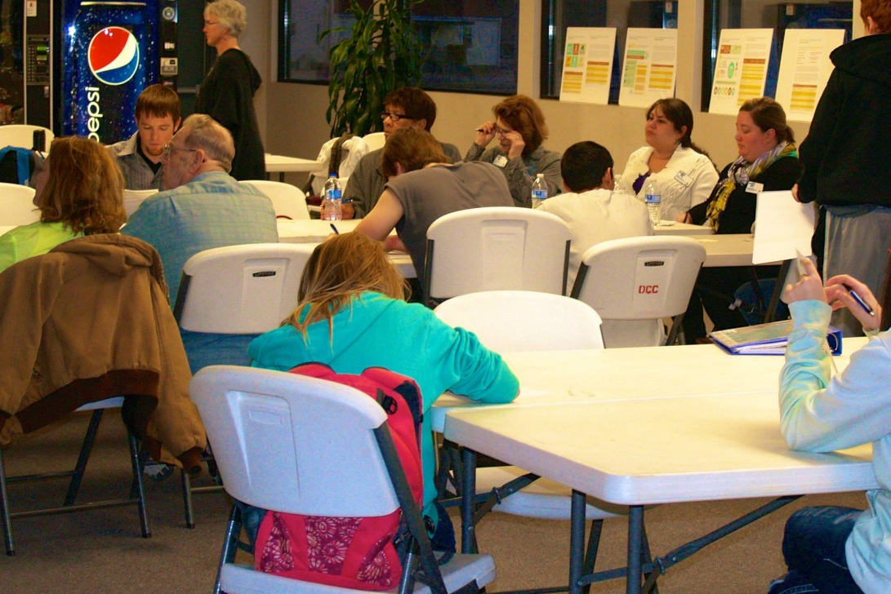
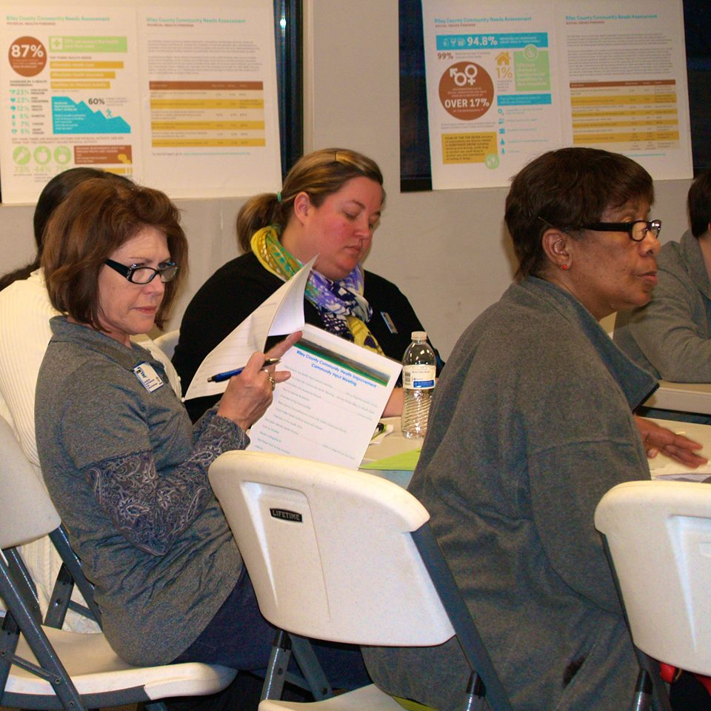
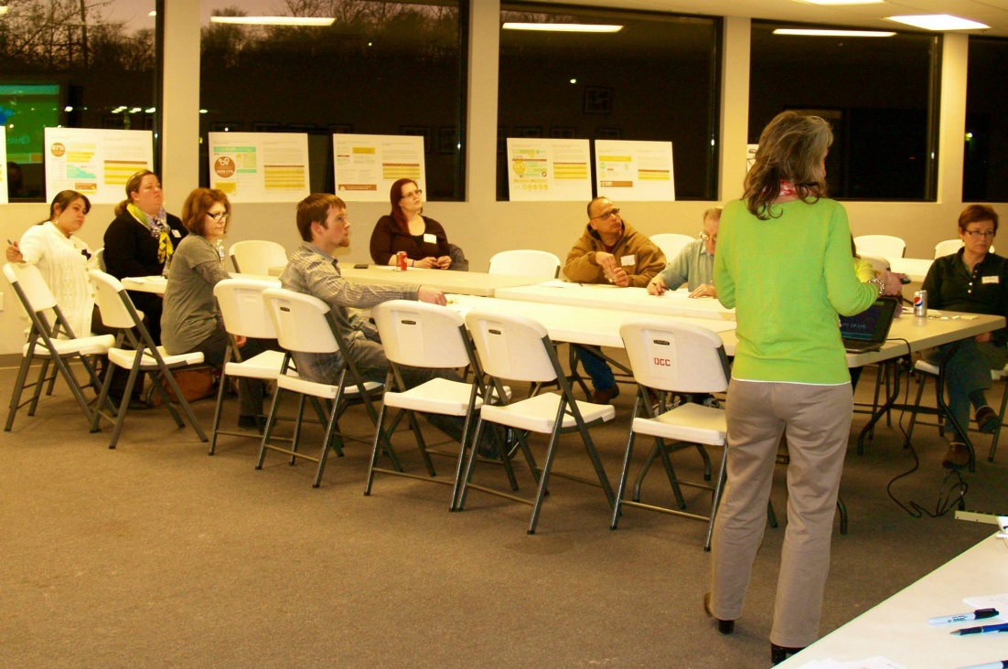
Ogden, February 24

Slide 45
Ogden Top Voting Results
February 24
Priority | Votes
Transportation Needs to be reliable, on time, affordable | 10
Health care needed in Ogden Pharmacy service needed Affordable Health Center | 10
Better, affordable housing | 6
No fresh fruits and veggies when out of season | 5
Drug use | 4
Clean water supply | 4
Mother and Infant Care | 4
Voting Results

Slide 46
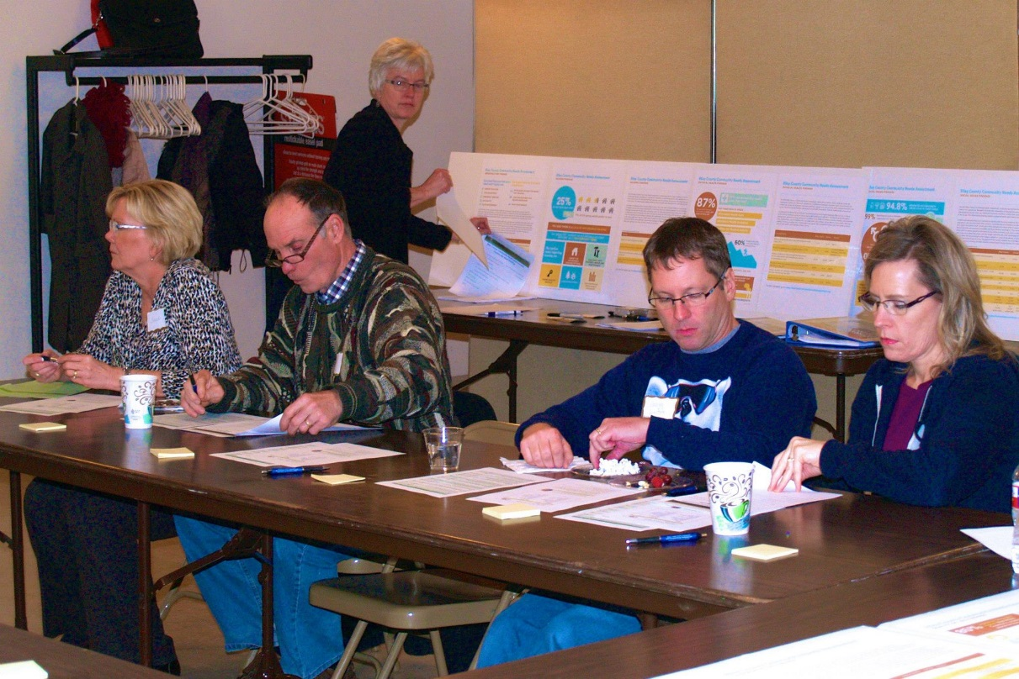
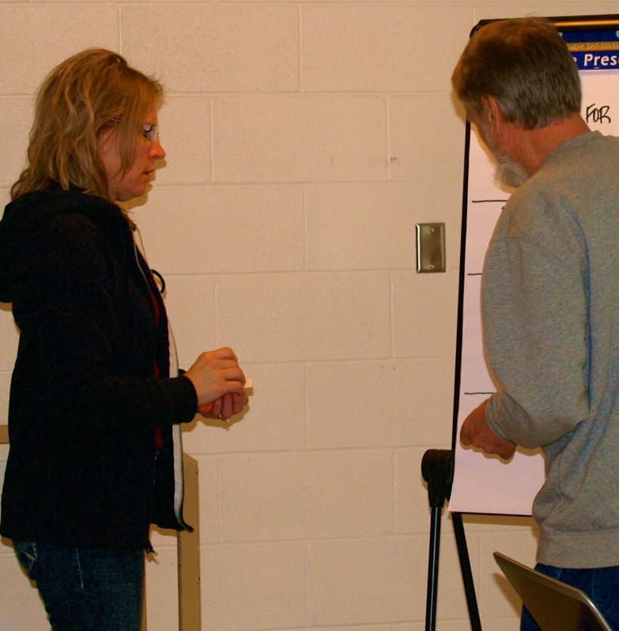
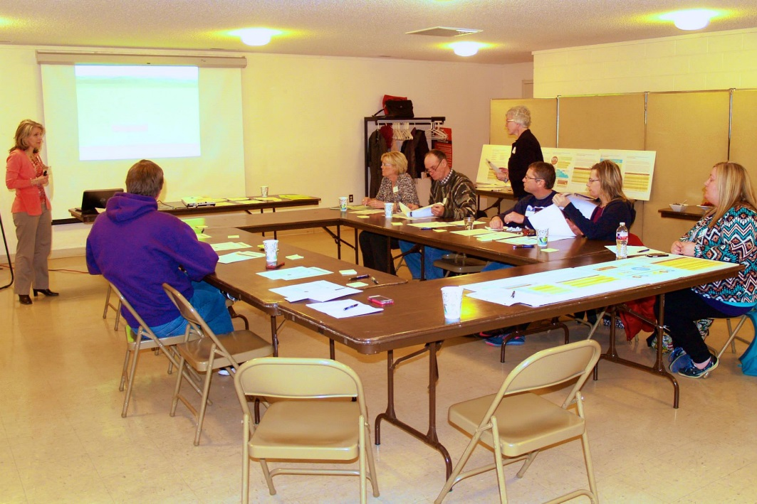
Keats, Feb 25

Slide 47
Keats Top Voting Results
February 25
Priority | Votes
Lack of Mental Health Services/Providers | 12
“Sick Child” Care Center | 7
Drugs & Alcohol | 5
Poverty | 4
Services for special needs | 3
Public transportation (better signage, wait times) | 3
Poor food choices available & made by parents | 3

Slide 48
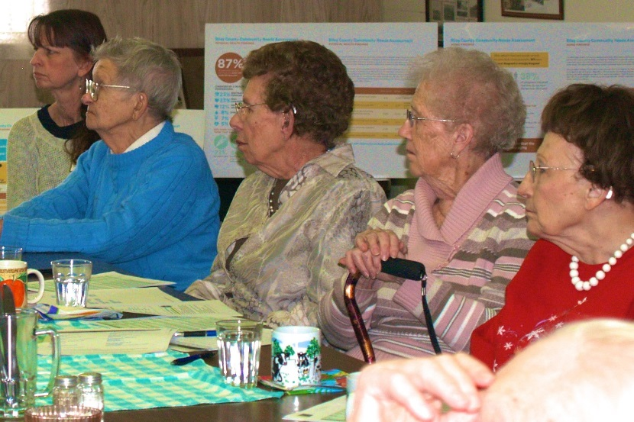
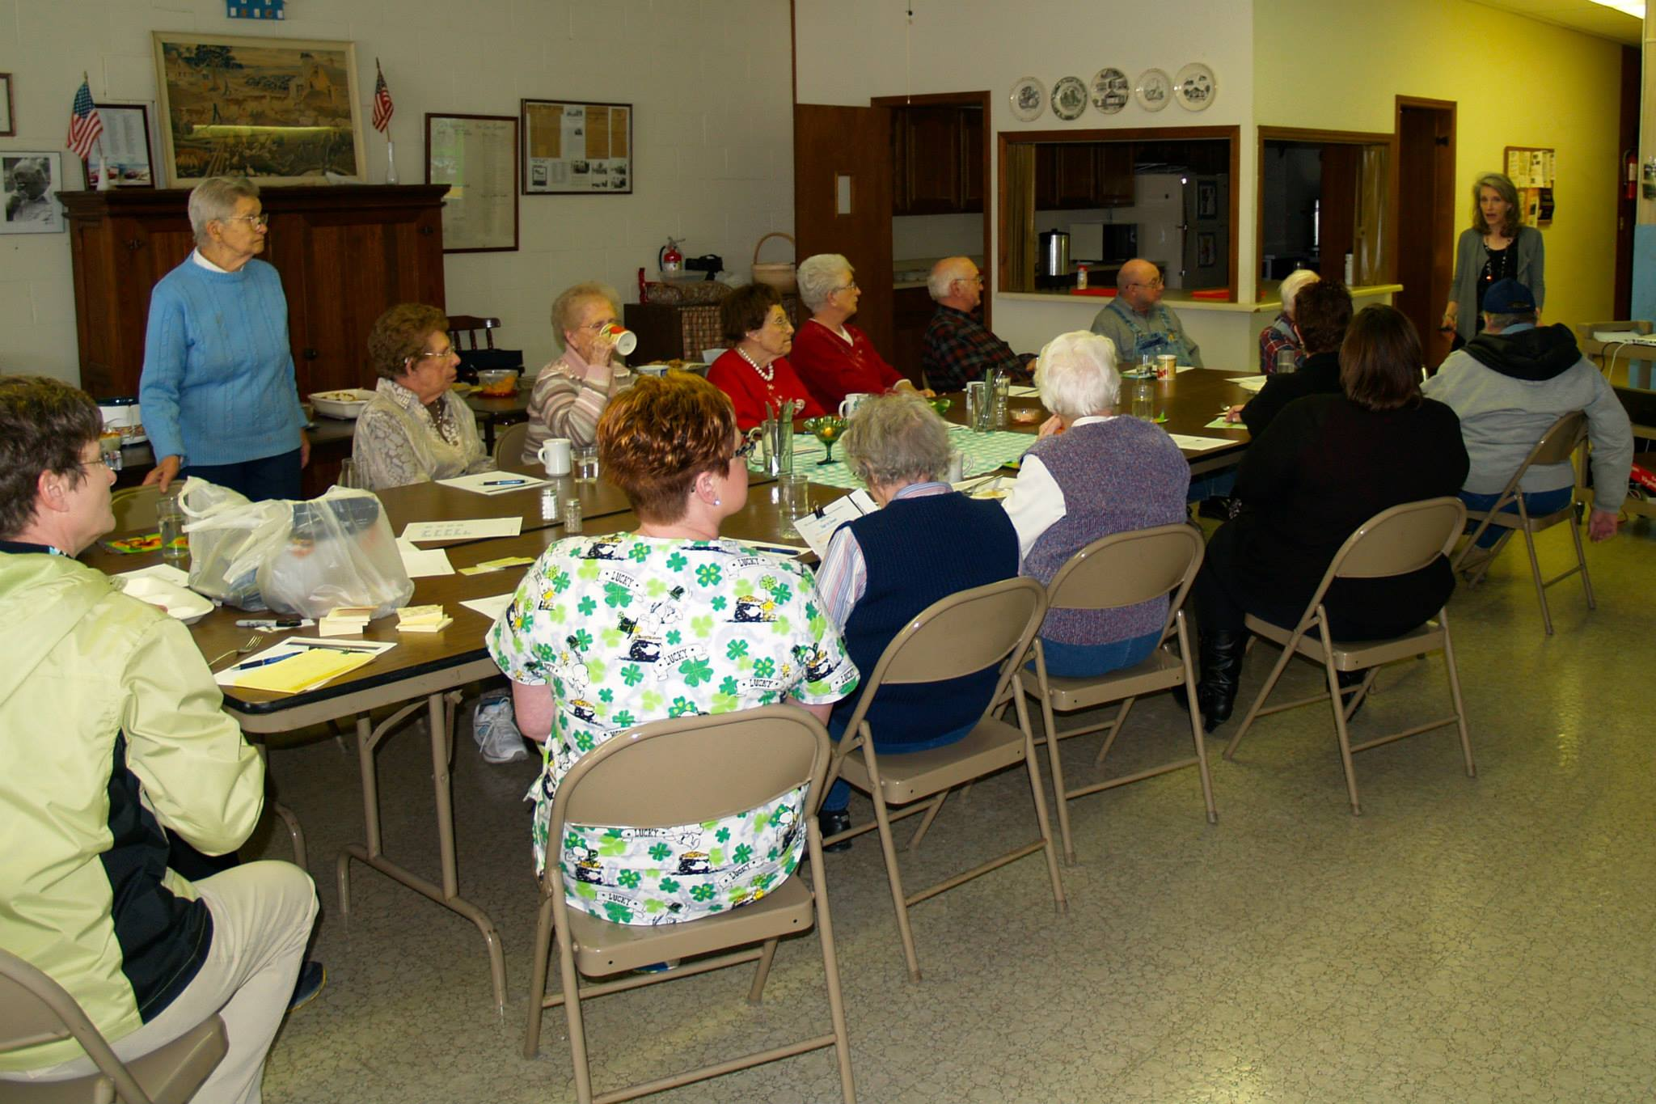
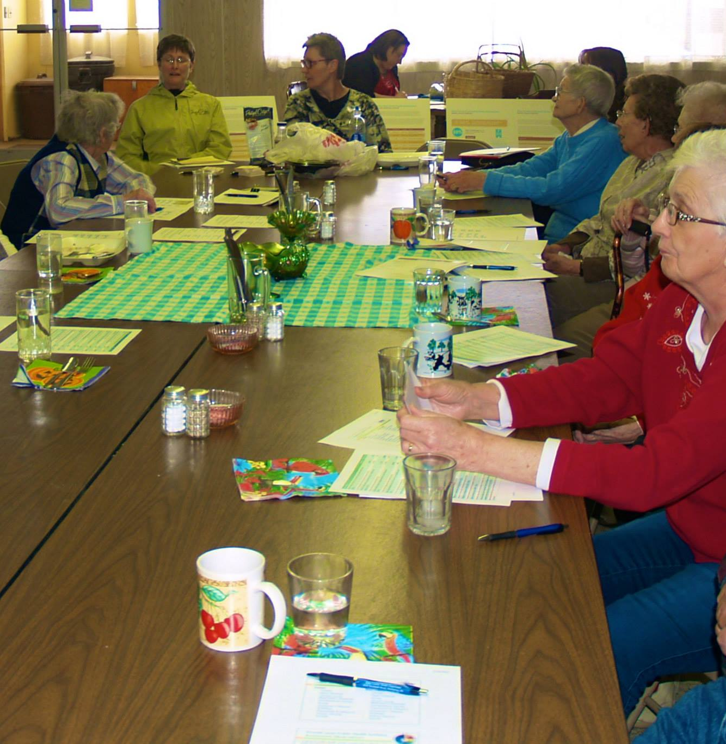
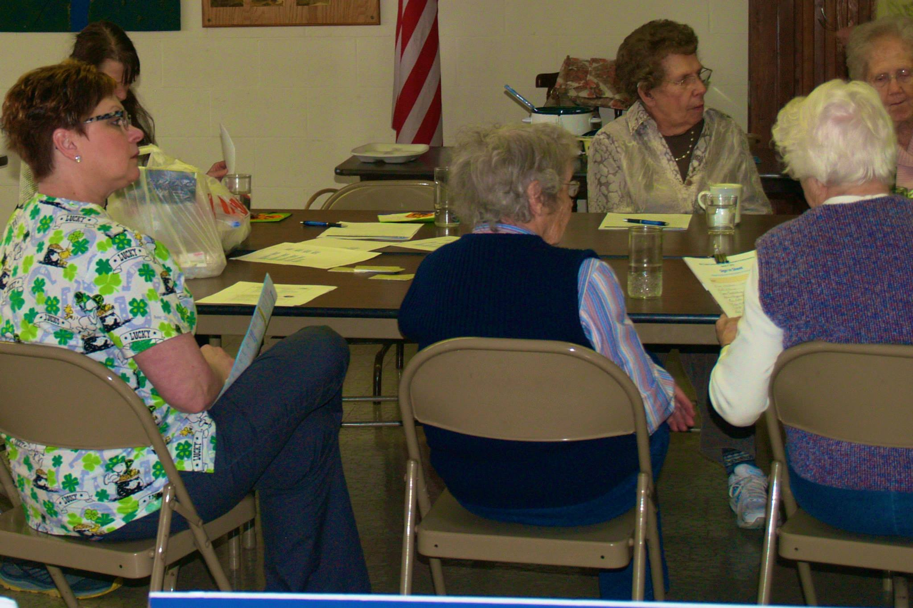
Randolph, March 2

Slide 49
Randolph #1 Top Voting Results
March 2
Priority | Votes
Transportation in N Riley County | 9
EMS Service Get “lost” # of responders (5 in Randolph) Can impact outcomes to people when EMS called Randolph EMS – no problems | 6
Physical Activity, Fitness | 2

Slide 50
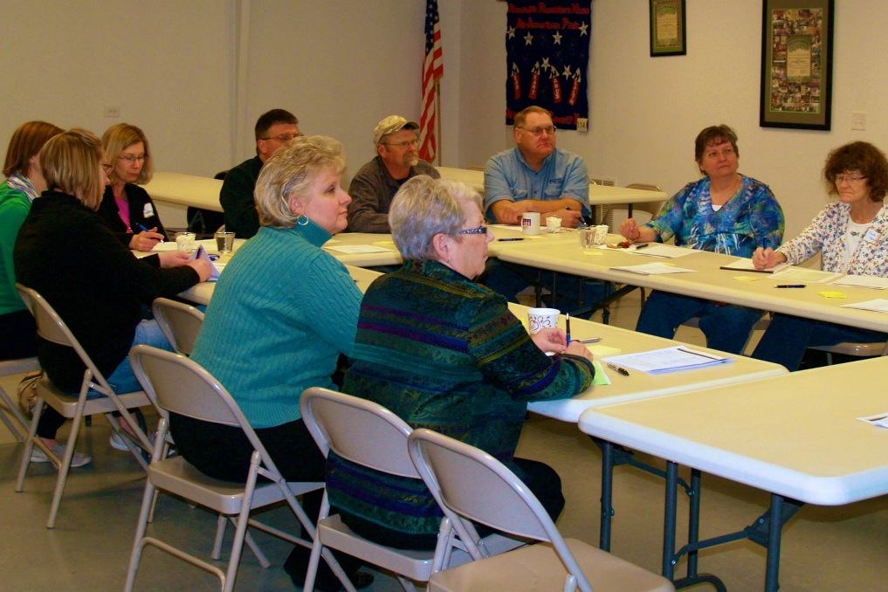
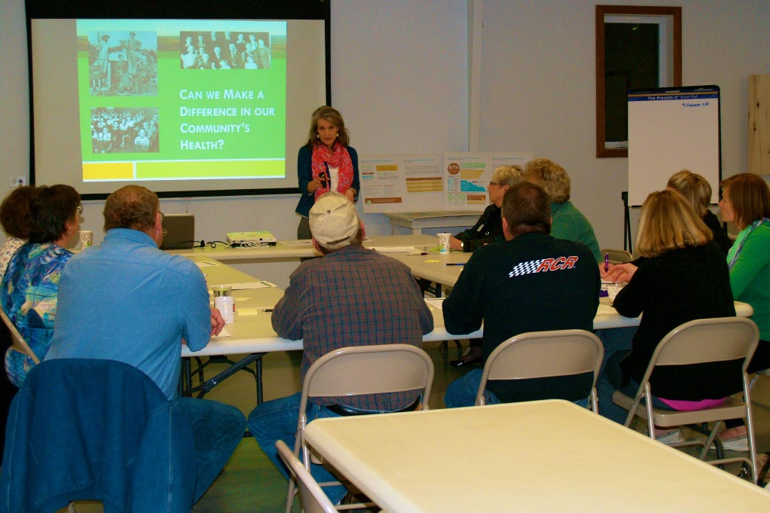
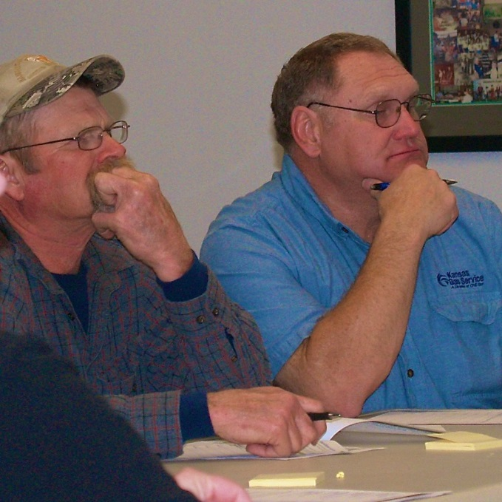
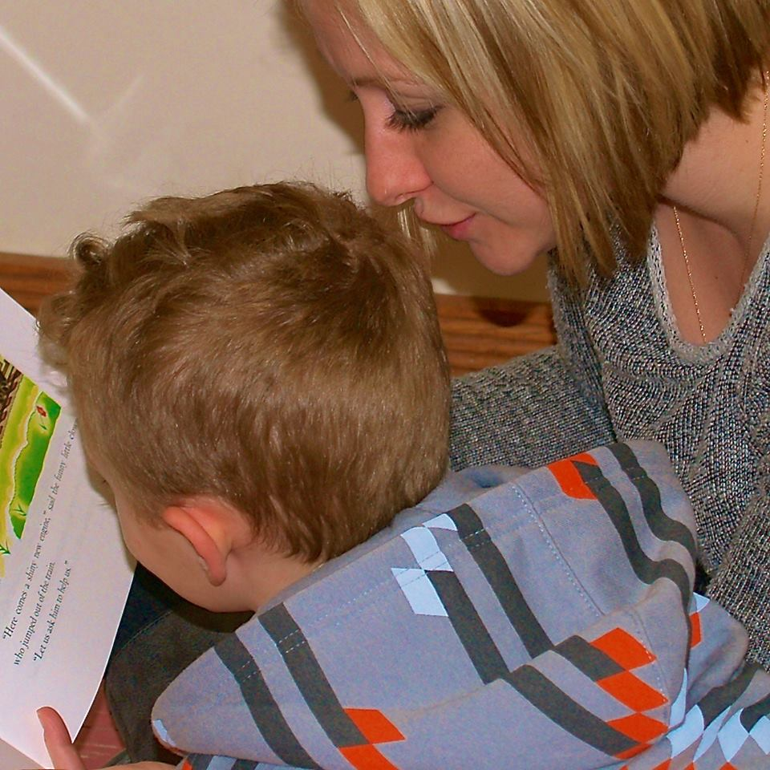
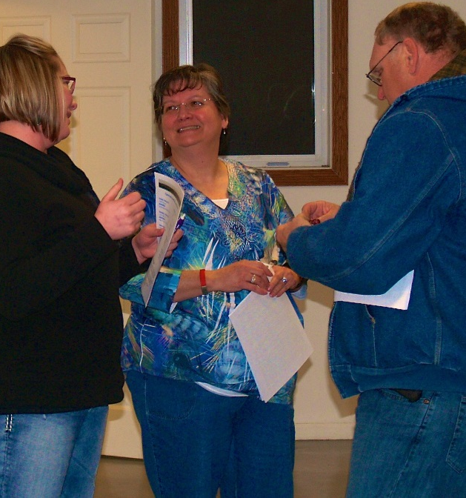
Randolph, March 4

Slide 51
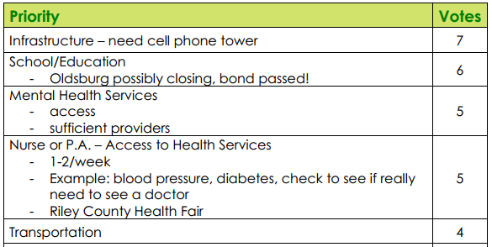
Randolph #2 Top Voting Results
March 4

Slide 52
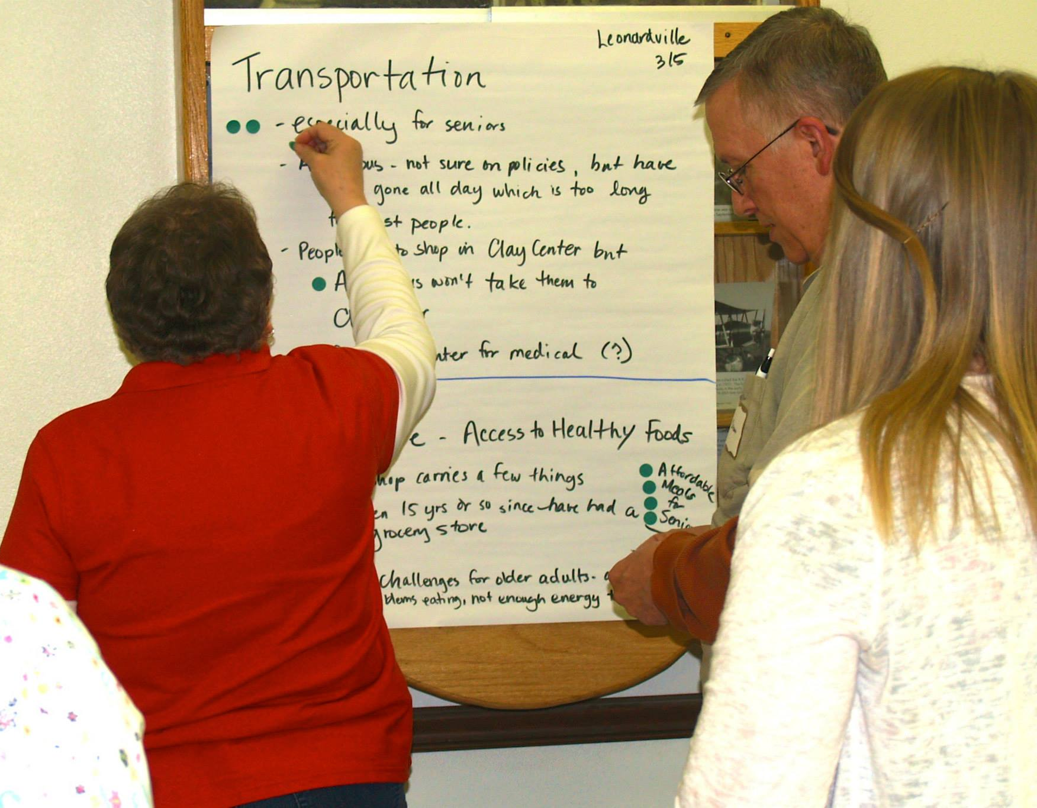
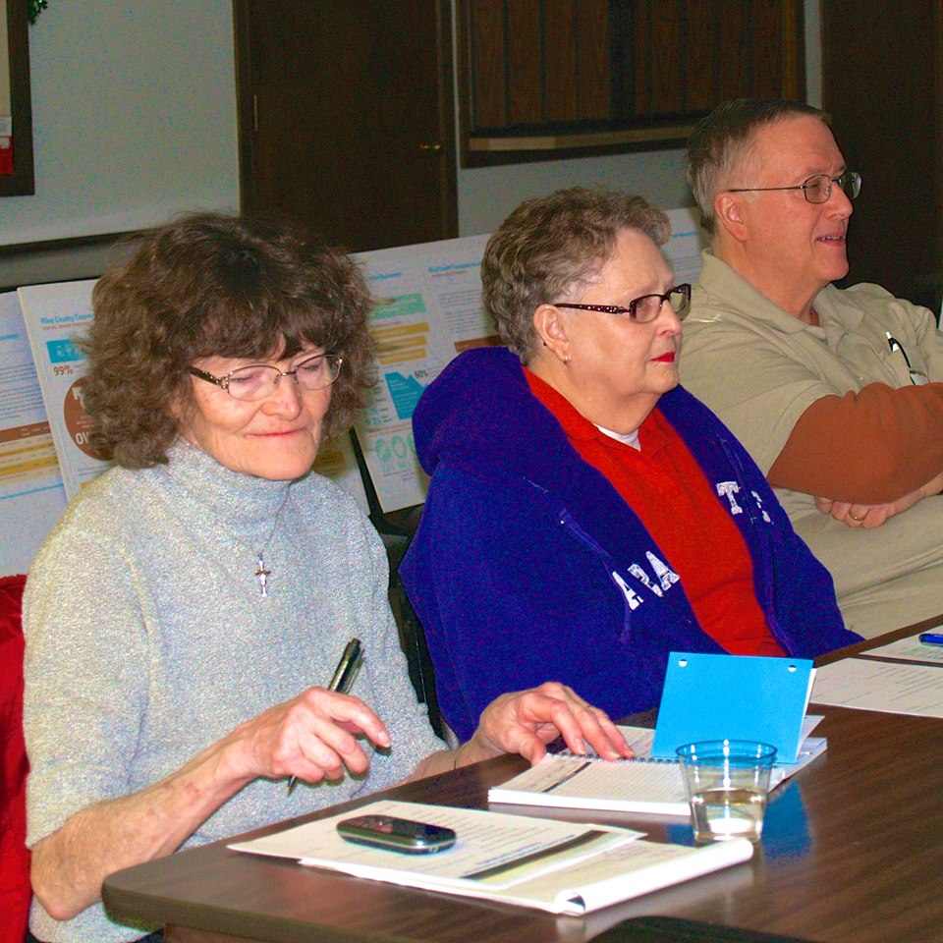
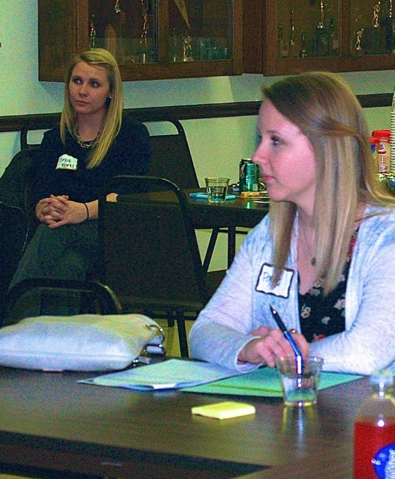
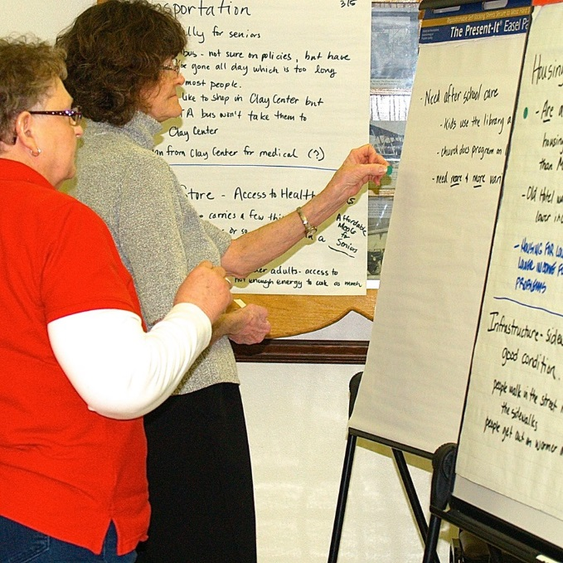
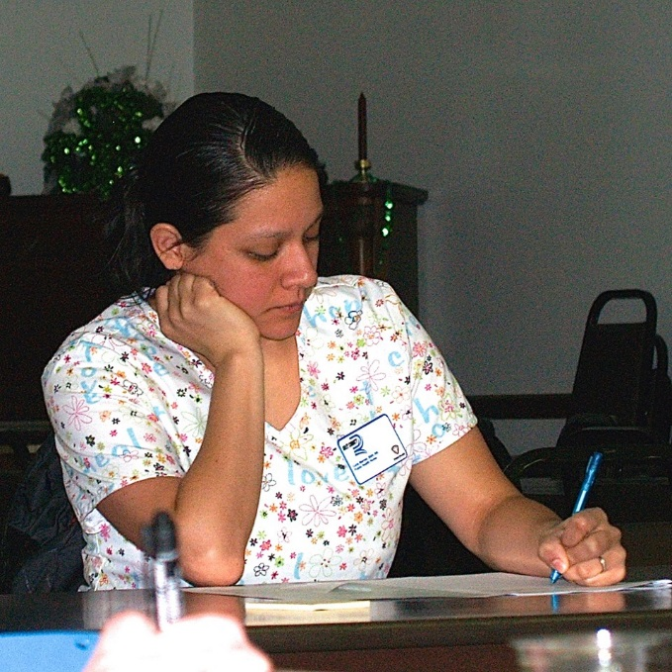
Leonardville, March 5

Slide 53
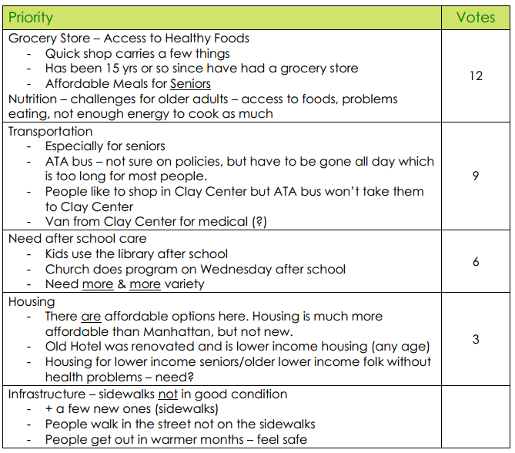
Leonardville #1 Top Voting Results
March 5

Slide 54
Comments
Relatively small numbers, but active & knowledgeable community members
Population 45 and older generally better represented; limited representation of young families
Rural communities had common themes of wanting to be better connected, have improved access – e.g., transportation, services offered directly in their communities
Differences among Riley County communities; not homogenous
Yet, some similar themes for all

Slide 55
Feedback from you?
Common themes noticed?
Same or different than what you’d expect?
In your opinion, what are the top health needs are that must be addressed in the next 3-5 years?

Slide 56
Resources
Riley County Community Health Improvement Planning process and meetings:
datacounts.net/rcchip/
Riley County Comprehensive Community Needs Assessment Results:
www.rileycountycommunityneedsassessment.org
Riley County Local Public Health System Assessment Results:
datacounts.net/lphsa/

Slide 57
Join us April 9th
3 – 5 pm
First United Methodist Church

